Slide 1

Semantic Code Search using Hypergraph Neural Networks
B. Tech. Project
Final Presentation on
Presented by
Pranjali Jadhav
112103052
Industrial Mentor
Samip Sharma
Project Guide
Dr. Y. V. Haribhakta
3rd May 2025

Slide 2
Contents
Introduction
Literature Survey
Limitations of current solutions
Problem Statement
Objectives
About the dataset
Proposed solution
Results
Conclusion
References

Slide 3
Introduction
Code Search is critical in navigating large and complex codebases
Newcomers struggle to translate intent into effective documentation search
There is a growing need for context-aware, semantic code retrieval systems

Slide 4
Semantic Code Search
What is Semantic Code Search?
Goes beyond keywords – understanding meaning behind queries
Matches natural language queries with relevant code snippets
Makes codebases more accessible

Slide 5
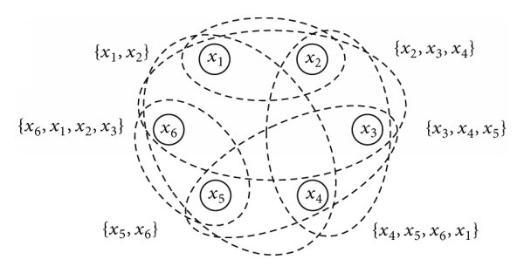
Hypergraph
A hypergraph extends a normal graph by allowing edges to connect multiple nodes at once
These multi-node edges are called hyperedges
Ideal for modeling group-based or semantic associations
A hypergraph can be formally represented as:
H = (V, E)
where
V is the set of nodes (vertices)
E subset of P(V) is a set of hyperedges
P(V) denotes power set of V i.e. the set of all possible subsets of nodes

Slide 6
Literature Survey
Title | Publications | Published date | Summary
Recent Advances in Hypergraph Neural Networks | arxiv.org | 11 March 2025 | The paper reviews various HGNN architectures, highlighting their strengths and applications. It emphasizes HGNNs’ ability to model complex multi-way relationships, making them effective for node classification, hyperedge prediction, and structured data representation.
You are AllSet: A Multiset Learning Framework for Hypergraph Neural Networks | arxiv.org | 28 March 2022 | A framework that models hypergraph propagation using multiset functions rather than traditional adjacency-based methods. By leveraging Deep Sets and Set Transformers, AllSet provides superior expressivity, flexibility, and scalability.

Slide 7
Literature Survey
Title | Publications | Published date | Summary
CodeBERT: A Pre-Trained Model for Programming and Natural Languages | arxiv.org | 18 September 2020 | CodeBERT is a bimodal pre-trained model that learns joint embeddings for natural language and programming languages. It uses a masked language modeling (MLM) and replaced token detection (RTD) objective to align code with comments/docstrings. It performs semantic code search by embedding queries and code snippets into a shared space, enabling retrieval based on meaning rather than syntax.
GraphCodeBERT: Pre-training Code Representations with Data Flow | arxiv.org | 13 September 2021 | GraphCodeBERT extends CodeBERT by incorporating the data flow graph of programs during pretraining. It represents both token-level structure and semantic dependencies, improving code understanding for tasks like code summarization and code search. This adds structural context to the embeddings, leading to more accurate semantic retrieval.

Slide 8
Problem Statement
Exploring Semantic Code Search using Hypergraph Neural Networks to capture higher-order multi-way relationships between functions and concepts.

Slide 9
Objectives
Capture higher-order relationships between functions and concepts using Hypergraph Neural Networks.
Retrieve top-k relevant code snippets for a given natural language query.
Learn meaningful function and concept embeddings through contrastive learning over hyperpaths.

Slide 10

About the Dataset
{
'id': '0',
'repository_name': 'organisation/repository',
'func_path_in_repository': 'src/path/to/file.py',
'func_name': 'func',
'whole_func_string': 'def func(args):\n"""Docstring"""\n [...]',
'language': 'python',
'func_code_string': '[...]',
'func_code_tokens': ['def', 'func', '(', 'args', ')', ...],
'func_documentation_string': 'Docstring',
'func_documentation_string_tokens': ['Docstring'],
'split_name': 'train',
'func_code_url': 'https://github.com/<org>/<repo>/blob/<hash>/src/path/to/file.py#L111-L150'
}
CodeSearchNet
Python subset
30,000 function-docstring pairs used for hypergraph construction

Slide 11
Proposed solution
Hypergraph-based neural retrieval system
Nodes = Functions and Concepts
Hyperedges = Concept co-occurrence sets linked to functions
Learns semantic relationships using contrastive learning
Inference ranks functions by structural order
Natural Language Query
Hypergraph-based encoder
Top-K ranked function codes

Slide 12
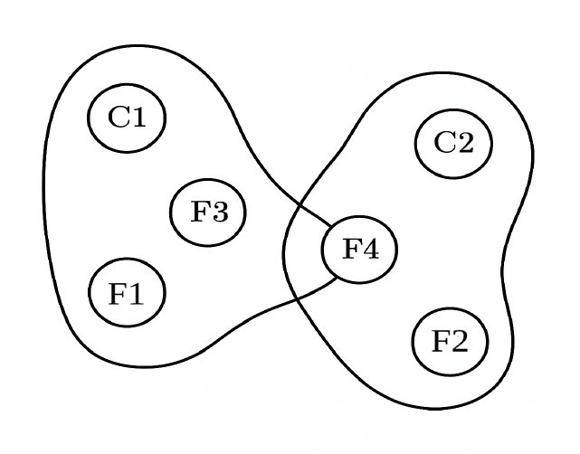
Hypergraph Construction Logic
Extract intent from function docstrings
Extract concepts from intent
Create concept + function (intent) nodes
Connect each function to its concept set via hyperedge
Concept embeddings via E5
Save as sparse incidence matrix

Slide 13
AllSet Transformer-based HGNN
Input – Node embeddings (concepts + functions) fed into the network
Architecture
Hypergraph Attention Layer
AllSet Transformer Model
Message passing
From hyperedges to nodes through attention mechanisms
Functions interact with functions, concepts interact with concepts
Output – Aligned embeddings in shared semantic space

Slide 14
Training Strategy
Step 1: Hyperpath construction – select top-K shared concept nodes for each batch
Step 2: Semantic anchoring – each function forms a hyperpath by aggregating embeddings of its associated concepts
Step 3: Positive and negative sampling – for each function match with own hyperpath (positive) and sample unrelated functions (negatives)
Step 4: Embedding generation – chunked forward pass through HGNN, normalize concept and function embeddings
Step 5: Training objective – bring function embeddings closer to their semantic hyperpaths, and away from unrelated ones.

Slide 15
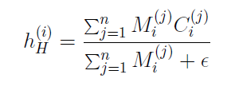
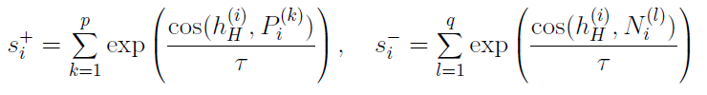

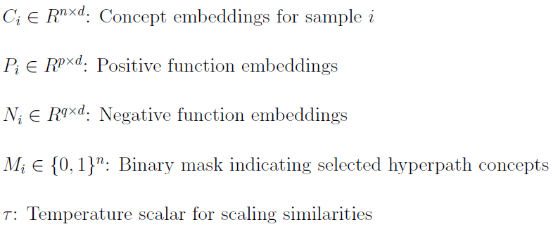
Contrastive Loss
Hyperpath-based constrastive loss
Objective – maximize similarity between hyperpaths and related functions, minimize it for unrelated ones.
Hyperpath-embedding – mean-pool selected concept embeddings using binary masks
Cosine similarity – Compute scaled similarity between hyperpath & positive / negative function embeddings
Contrastive softmax pushes similarity with own hyperpath up, pushes others away
Batch-averaged loss – final loss is averaged across training batch

Slide 16
Inference
Query
Encoder
Concept match
Hyperpaths
Aggregation
Similarity comparison
Ouput
Encode query using E5
Match top-k concepts
Retrieve hyperpaths with these concepts
Aggregate via attention with query
Score functions using embedding similarity
Output – top-K ranked functions

Slide 17
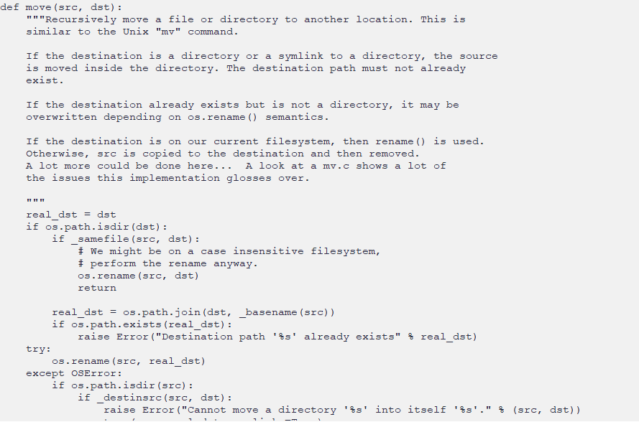
Inference Example 1
Q. How to move a file to a different folder?

Slide 18
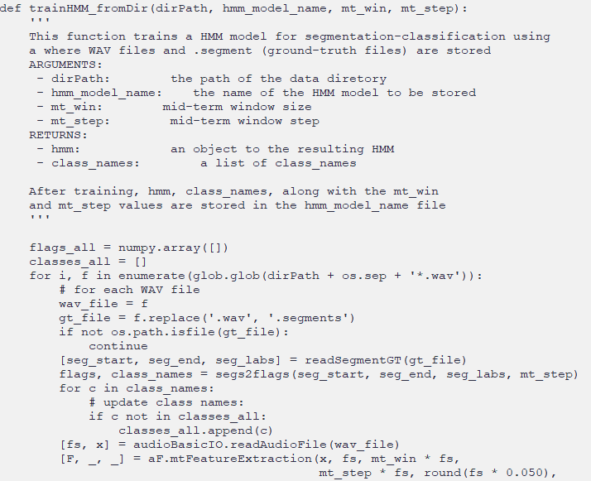
Inference Example 2
Q. How to train an HMM model for classification?

Slide 19
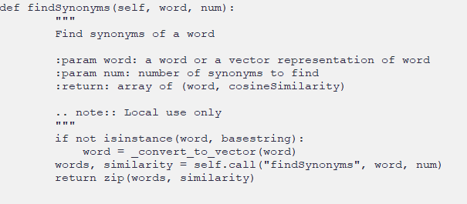
Inference Example 3
Q. How to find synonyms of a word?

Slide 20
Why Hypergraphs?
Beyond one-to-one matching
Intent often resides in combinations of concepts, not isolated tokens
Hypergraphs capture higher-order relationships
Why it matters for code search? – retrieval requires understanding intent

Slide 21
Results
What is NDCG?
Normalized Discounted Cumulative Gain(NDCG) measures how well the model ranks retrieved function codes based on their semantic relevance to human-annotated ground-truth functions.
Evaluation metric
NDCG@3 based on graded relevance from SBERT-based cosine similarity
Ground-truth relevance derived from human annotations
Evaluation dataset
99 natural language queries from CodeSearchNet
Each query contains 3 ranked ground truths
Models compared
HGNN (proposed) | CodeBERT | SBERT | E5-small-v2

Slide 22
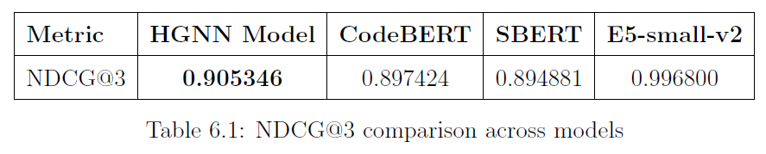
Results

Slide 23
Conclusion
The proposed semantic code method using Hypergraph Neural Networks (HGNNs) is able to model complex relationships between code functions and conceptual keywords. The work highlights the potential of hypergraph-based models for improving code search and recommendation. The model helps enhance developer productivity and streamlines the API search process.

Slide 24
References
[1] Z. Feng, D. Guo, D. Tang, N. Duan, X. Feng, M. Gong, L. Shou, B. Qin, T. Liu, and D. Jiang, ”CodeBERT: A Pre-Trained Model for Programming and Natural Languages,” in Proceedings of the 2020 Conference on Empirical Methods in Natural Language Processing (EMNLP), 2020, pp. 1536–1547.
[2] D. Guo, S. Ren, S. Lu, A. Tang, and D. Guo, ”GraphCodeBERT: Pretraining Code Representations with Data Flow,” in International Conference on Learning Representations (ICLR), 2021.
[3] J. Guo, Z. Feng, D. Tang, N. Duan, and M. Gong, ”UniXcoder: Unified Cross-Modal Pre-training for Code Understanding and Generation,” in Proceedings of the 60th Annual Meeting of the Association for Computational Linguistics (ACL), 2022.
[4] D. Martins Gerosa, R. Prikladnicki, and D. Poshyvanyk, ”Neural Code Retrieval by Jointly Embedding Code and Queries,” in IEEE/ACM 42nd International Conference on Software Engineering Workshops (ICSEW), 2020.
[5] X. Zhang, J. Li, D. Chen, Y. Zhou, and M. Zhao, ”A Novel Approach for Code Search: Integrating BM25 with Code-Aware Tokenization,” in Proceedings of the 43rd International Conference on Software Engineering (ICSE), 2021.
[6] X. Gu, H. Zhang, D. Zhang, and S. Kim, ”Deep Code Search,” in Proceedings of the 40th International Conference on Software Engineering (ICSE), 2018, pp. 933–944.
[7] Z. Sun, S. Wang, Y. Liu, and X. Du, ”A Path-Based Neural Model for Code Search,” in Proceedings of the 28th ACM Joint Meeting on European Software Engineering Conference and Symposium on the Foundations of Software Engineering (ESEC/FSE), 2020.
[8] A. Haldar, K. Sankaralingam, and L. Tang, ”Code Retrieval with Multi- Modal Transformers,” in Proceedings of the 2020 Conference on Empirical Methods in Natural Language Processing (EMNLP), 2020.

Slide 25
References
[9] C. Kuang, K. Yang, and J. Tan, ”Improving Code Search with Co- Attentive Dual Representation Learning,” in Proceedings of the 44th International ACM SIGIR Conference on Research and Development in Information Retrieval, 2021.
[10] F. Zhang, C. Shi, M. Yang, S. Wang, and B. Cui, ”Hyper-SAGNN: A Self-Attention Based Graph Neural Network for Hypergraphs,” in Proceedings of the 27th ACM International Conference on Information and Knowledge Management (CIKM), 2018.
[11] A. Chien, C. Qian, and C. Shah, ”AllSet: Hypergraph Transformer for Set Representation Learning,” in International Conference on Machine Learning (ICML), 2022.
[12] X. Wang, H. Huang, J. Ye, and E. Xu, ”Multi-Similarity Loss with General Pair Weighting for Deep Metric Learning,” in Proceedings of the IEEE/CVF Conference on Computer Vision and Pattern Recognition (CVPR), 2019.
[13] H. Robertson, ”An Introduction to Hypergraphs and Their Applications in Machine Learning,” arXiv preprint arXiv:2010.14534, 2020.
[14] C. Robertson and Y. Li, ”A Survey on Hypergraph Neural Networks,” IEEE Transactions on Pattern Analysis and Machine Intelligence (TPAMI), 2022.
[15] CodeSearchNet Challenge Dataset, GitHub Repository, Available: https://github.com/github/CodeSearchNet.

